Slide 1

E-Commerce (Online Shopping Store)
COURSE INSTRUCTOR: | Shaikh Shawon Arefin Shimon
CORSE TITLE: | cse299
SECTION: | 08
NAME | ID
MD ANIKUL ISLAM | 1520086042
Mitu Rani Das | 1512383642
Asiful Alam Fahim | 1521551042

Slide 2
E-Commerce in Bangladesh
E-Commerce website development in Bangladesh nowadays is a moneymaking or profitable business. E-Commerce website development in Bangladesh nowadays is a moneymaking or profitable business. This project is organized for an e-Commerce site for any small to medium shopping store. This project has been designed for solving current problems of many e-Commerce sites in Bangladesh. These websites are not updated regularly, and there are also SPAM and MARKETING STRATEGY issues which give negative impression to the user and the customers.

Slide 3
Technical approach
Our goal is to avoid those possible problems that we mentioned earlier and also create more error free, updated, reliable and licensed web applications to the users and the customers. We are going to make an e-Commerce site which contains User and Admin Interfaces. The information of admins and users will be arranged in a database. The database can be only accessed by the admins.

Slide 4
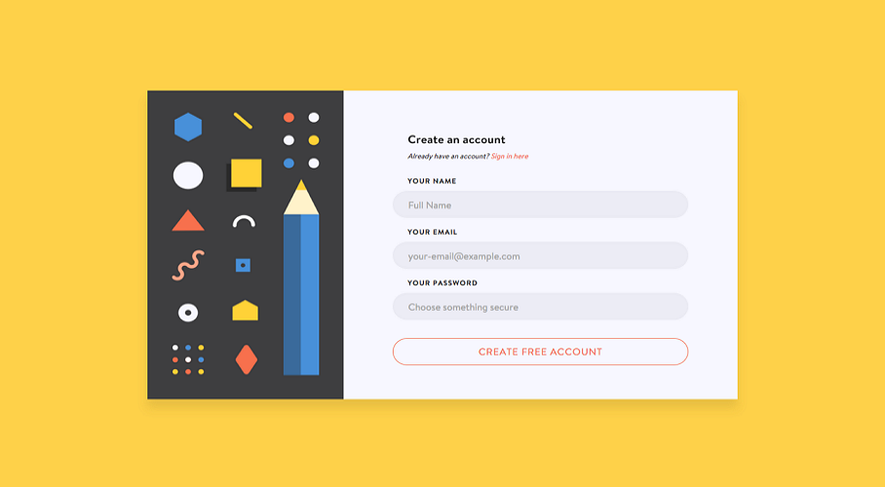
web interface
a) Registration.
b) Log in -
● User Name.
● Password.
c) Search Key.

Slide 5


Payment method -

